Slide 1



Ethics

Slide 2
What is Ethics?
Ethics is defined as a method, procedure, or perspective for deciding how to act and for analyzing complex problems and issues (Resnik, 2020)​
When it comes to research, ethics refer to the norms and values that guide decisions regarding the collection of data and analysis of said data, as well as the dissemination of findings (Mirza, Bellalem & Mirza, 2023).
“If a choice must be made between doing harm to a participant and doing harm to the research, it is the research that is sacrificed.” (Mack et al., 2005)
Resnik, D. B. (2020). What is Ethics in Research & Why is it Important? National Institute of Environmental Health Sciences.
Mirza, H., Bellalem, F., & Mirza, C. (2023). Ethical Considerations in Qualitative Research: Summary Guidelines for Novice Social Science Researchers.​
Mack et al. (2005). Qualitative Research Methods: A Data Collector's Field Guide​

Slide 3

Ethical Considerations
According to Mirza, Bellalem, & Mirza (2023) these are some key ethical considerations:
​Respect for persons – Treating participants with dignity.​
Informed consent – Voluntary and informed agreement.​
Confidentiality & anonymity – Protecting identities.​
Trustworthiness – Ensuring integrity and transparency.​
Avoiding harm – Psychological, emotional, or reputational.​
Conflict of interest – Maintaining objectivity.​
Santa Clara University (2019)​
https://www.scu.edu/mobi/resources--tools/blog-posts/ethics-in-life-and-business/ethics-in-life-and-business.html
Mirza, H., Bellalem, F., & Mirza, C. (2023). Ethical Considerations in Qualitative Research: Summary Guidelines for Novice Social Science Researchers.​

Slide 4
Qualification Research
Qualification research means research conducted in fulfilment, or partial fulfilment, of a qualification.
Qualification research must be ethically approved by a REC situated within the University.
Ethical approval is in place before research data collection or any interaction with research participants commences.
Ethical approval is renewed if and when this is required.
Any amendments to ethically approved research are managed in accordance with Faculty research ethics operating procedures.
Adverse events occurring during research are reported in accordance with Faculty research ethics operating procedures.
Retrospective ethical approval will not be considered under any circumstances.
Research requiring secondary use of existing data requires prospective ethical approval.

Slide 5
Responsibilities of Faculty REC
The objective of the REC is to protect the interests of research participants and research affiliates.
Faculty RECs are responsible for ensuring that the proposed and amended research meets relevant ethical norms and standards and is aligned with the guiding principles of research ethics.
Faculty RECs have the right to suspend research pending an inquiry into unethical research conduct, as detailed in their standard operating procedure (SOP).

Slide 6
Responsibilities of Faculty REC
The JBS REC cannot approve studies that are outside its purview of business-related subject matters.
Types of research studies that the JBS REC cannot approve. This list is not exhaustive and will be specific to the study.
Involve participation of public health facilities staff or patients. These studies must be approved by a registered REC, which is the Faculty of Health Sciences (FHS). For any application to serve at the FHS REC, the application must include evidence of ethics training for both the researcher and the supervisor.
Studies that research criminal activities must get approval from the South African Information Regulator.

Slide 7
Protection of Personal Information Act (POPIA)
The purpose of POPIA is (extracted from https://popia.co.za):
“to promote the protection of personal information processed by public and private bodies;
to introduce certain conditions so as to establish minimum requirements for the processing of personal information;
to provide for the rights of persons regarding unsolicited electronic communications and automated decision making;
to regulate the flow of personal information across the borders of the Republic; and to provide for matters connected therewith.”

Slide 8
Definitions as Related to POPIA (extracted from https://popia.co.za)
“Personal information relates to an identifiable, living, natural person, and where applicable, an identifiable, existing juristic person.
information relating to the race, gender, sex, pregnancy, marital status, national, ethnic or social origin, colour, sexual orientation, age, physical or mental health, well-being, disability, religion, conscience, belief, culture, language and birth of the person;
information relating to the education or the medical, financial, criminal or employment history of the person;
any identifying number, symbol, e-mail address, physical address, telephone number, location information, online identifier or other particular assignment to the person;
the biometric information of the person;
the personal opinions, views or preferences of the person;
correspondence sent by the person that is implicitly or explicitly of a private or confidential nature or further correspondence that would reveal the contents of the original correspondence;
the views or opinions of another individual about the person; and
the name of the person if it appears with other personal information relating to the person or if the disclosure of the name itself would reveal information about the person”

Slide 9
Definitions as Related to POPIA (extracted from https://popia.co.za)
‘‘Special personal information means personal information as referred to in section 26,” of the act and includes religious beliefs, criminal acts, political persuasion, health or sex life, etc. Please refer to POPIA for further details.
‘‘Processing means any operation or activity or any set of operations, whether or not by automatic means, concerning personal information, including
The collection, receipt, recording, organisation, collation, storage, updating or modification, retrieval, alteration, consultation or use;
dissemination by means of transmission, distribution or making available in any other form; or merging, linking, as well as restriction, degradation, erasure or destruction of information”;

Slide 10
Definition as Related to POPIA (extracted from https://popia.co.za)
‘‘Record means any recorded information
Regardless of form or medium, including any of the following:
Writing on any material;
information produced, recorded or stored by means of any tape-recorder, computer equipment, whether hardware or software or both, or other device, and any material subsequently derived from information so produced, recorded or stored;
label, marking or other writing that identifies or describes any thing of which it forms part, or to which it is attached by any means;
book, map, plan, graph or drawing;
photograph, film, negative, tape or other device in which one or more visual images are embodied so as to be capable, with or without the aid of some other equipment, of being reproduced;
in the possession or under the control of a responsible party;
whether or not it was created by a responsible party; and
regardless of when it came into existence;”

Slide 11
POPIA Adherence (extracted from https://popia.co.za)
If you do process personal or special personal information as part of your study, you must submit the following, as per the provided templates:
Justification for collection of the personal or special personal information as related to you study.
POPI information letter and consent
Additional information may be requested following review.

Slide 12
Ethics Process
Research ethics applies to undergraduate and postgraduate students, postdoctoral research fellows (PDRFs), full-time and part-time staff, visiting academics and research associates, or any other person engaging in research and affiliating themselves to the University in the process.
Research begins when a research ethics application receives ethical approval, and research ends when data collection and analysis is complete.
Ethical approval means the outcome of a process of ethical review by a research ethics committee (REC) indicating that research has complied with the required ethical norms and standards.

Slide 13
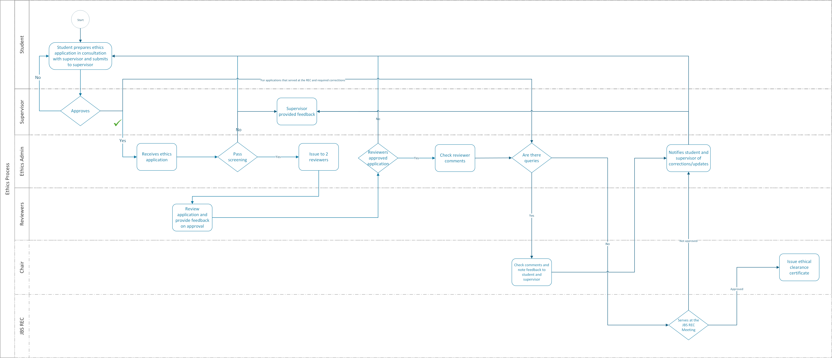
Ethics Process

Slide 14
Primary Data Collection
Data is gathered directly from humans via interviews, survey, focus groups, questionnaires, etc.
Data is gathered from animals
This approach requires Form A to be completed
For any study that conducts primary data gathering, the Personal Information Impact Assessment must be completed

Slide 15
Minimum Requirements for Submission of Form A
Request to conduct study at organization
Permission/Waiver letter from the organization/s if applicable.
The permission letter must be on a company letter head, signed and dated.
Must be signed by an authorized person
In some cases, the organization may request ethical clearance first, if applicable, proof of request must be submitted during ethics application. If clearance is granted, it will be conditionally granted until the permission is received and reviewed by the JBS REC. Until final permission is provided by the REC, no data collection can commence.
Informed consent
There is a template but must be contextualized to the requirements of the study
POPIA information template and consent, if required

Slide 16
Minimum Requirements for Submission of Form A
Interview questions/ focus groups questions/surveys
Once these questions have been approved by the JBS REC, there cannot be changes, any changes must go through an amendment process.
For existing questionnaires, details of use must be clearly stated.
It is the responsibility of the student and supervisor to ensure adherence to rules of use.
Completed Personal Information Impact Assessment Form.
Completed Form A
Signed and dated by both student and supervisor.

Slide 17
Secondary Data Collection
Data is gathered from secondary sources. There is no engagement/interaction with human or animals.
This requires Form B to be completed
If private data is to be used, company permission/waiver must be submitted.
The permission letter must be on a company letter head, signed and dated.
Must be signed by an authorized person

Slide 18
Minimum Requirements for Submission of Form B
Request to conduct study at organization
Permission/Waiver letters from the organization/s if applicable.
The permission letter must be on a company letter head, signed and dated.
Must be signed by an authorized person
In some cases, the organization may request ethical clearance first, if applicable proof of request must be submitted during ethics application. If clearance is granted, it will be conditionally granted until the permission is received and reviewed by the JBS REC. Until final permission is provided by the REC, no data collection can commence.
Completed Form B
Signed and dated by both student and supervisor
Based on the data to be collected, PIIA may be required.
Identifiable company information

Slide 19
Ethical Clearance Exemption
Only secondary data is used and from publicly available sources. There is no engagement/interaction with human or animals and no private data usage.
Form C to be completed

Slide 20
Resubmission
When resubmitting any ethical clearance, the complete pack must be resubmitted.
All updated documents must be signed and dated by both student and supervisor.
A summary document detailing the changes requested must be provided. Align to the feedback received from the JB REC.

Slide 21
Amendments
When an amendment is requested, the data collection must halt.
An amendment application would be reviewed in totality.
All submission documents must be updated and sent together with the amendment document, which details the amendment.

Slide 22
Ethics App
All ethics applications must be submitted via the ethics app. No Moodle or email applications will be accepted.
All ethics app queries must be directed to: jbsethicsapphelpdesk@uj.ac.za.

